Slide 1

軟體測試
group9
310551124 官學勤 310555020 鄭旭翔 310555021 黃浩軒 310581027 宋煜祥

Slide 2
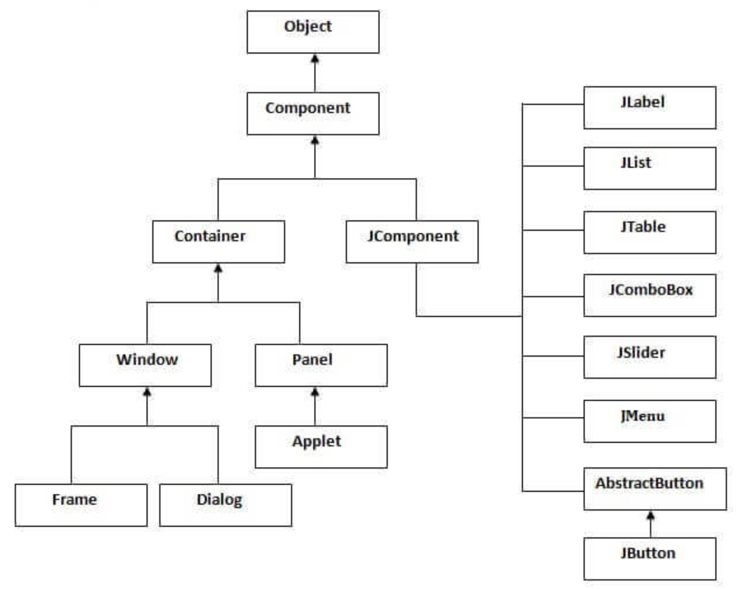
GUI
Swing

Slide 3
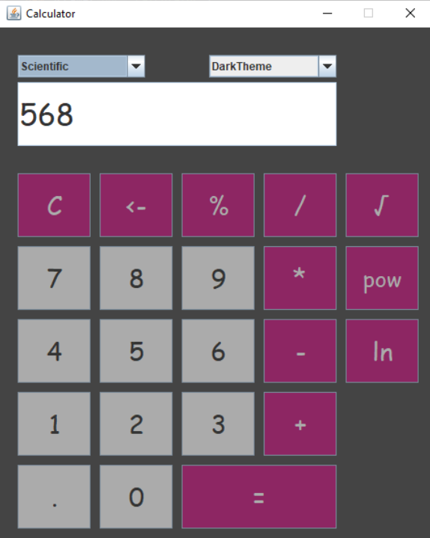
Calculator
Unit Testing
Logic Coverage
Graph Coverage
Continuous Integration
https://github.com/HouariZegai/Calculator

Slide 4
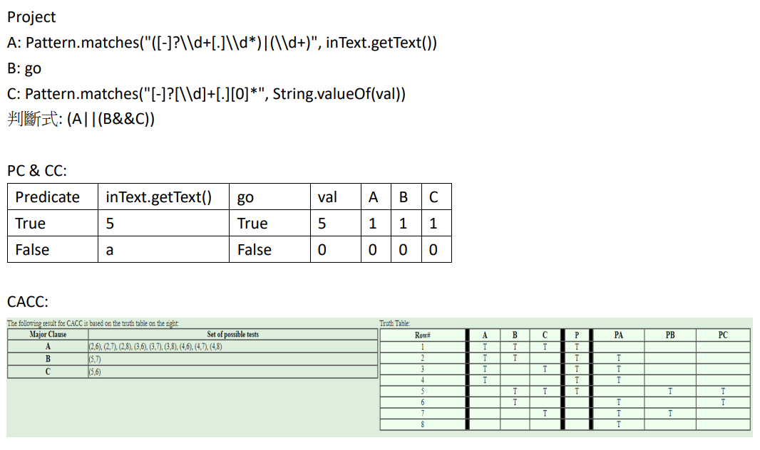
Logic coverage

Slide 5
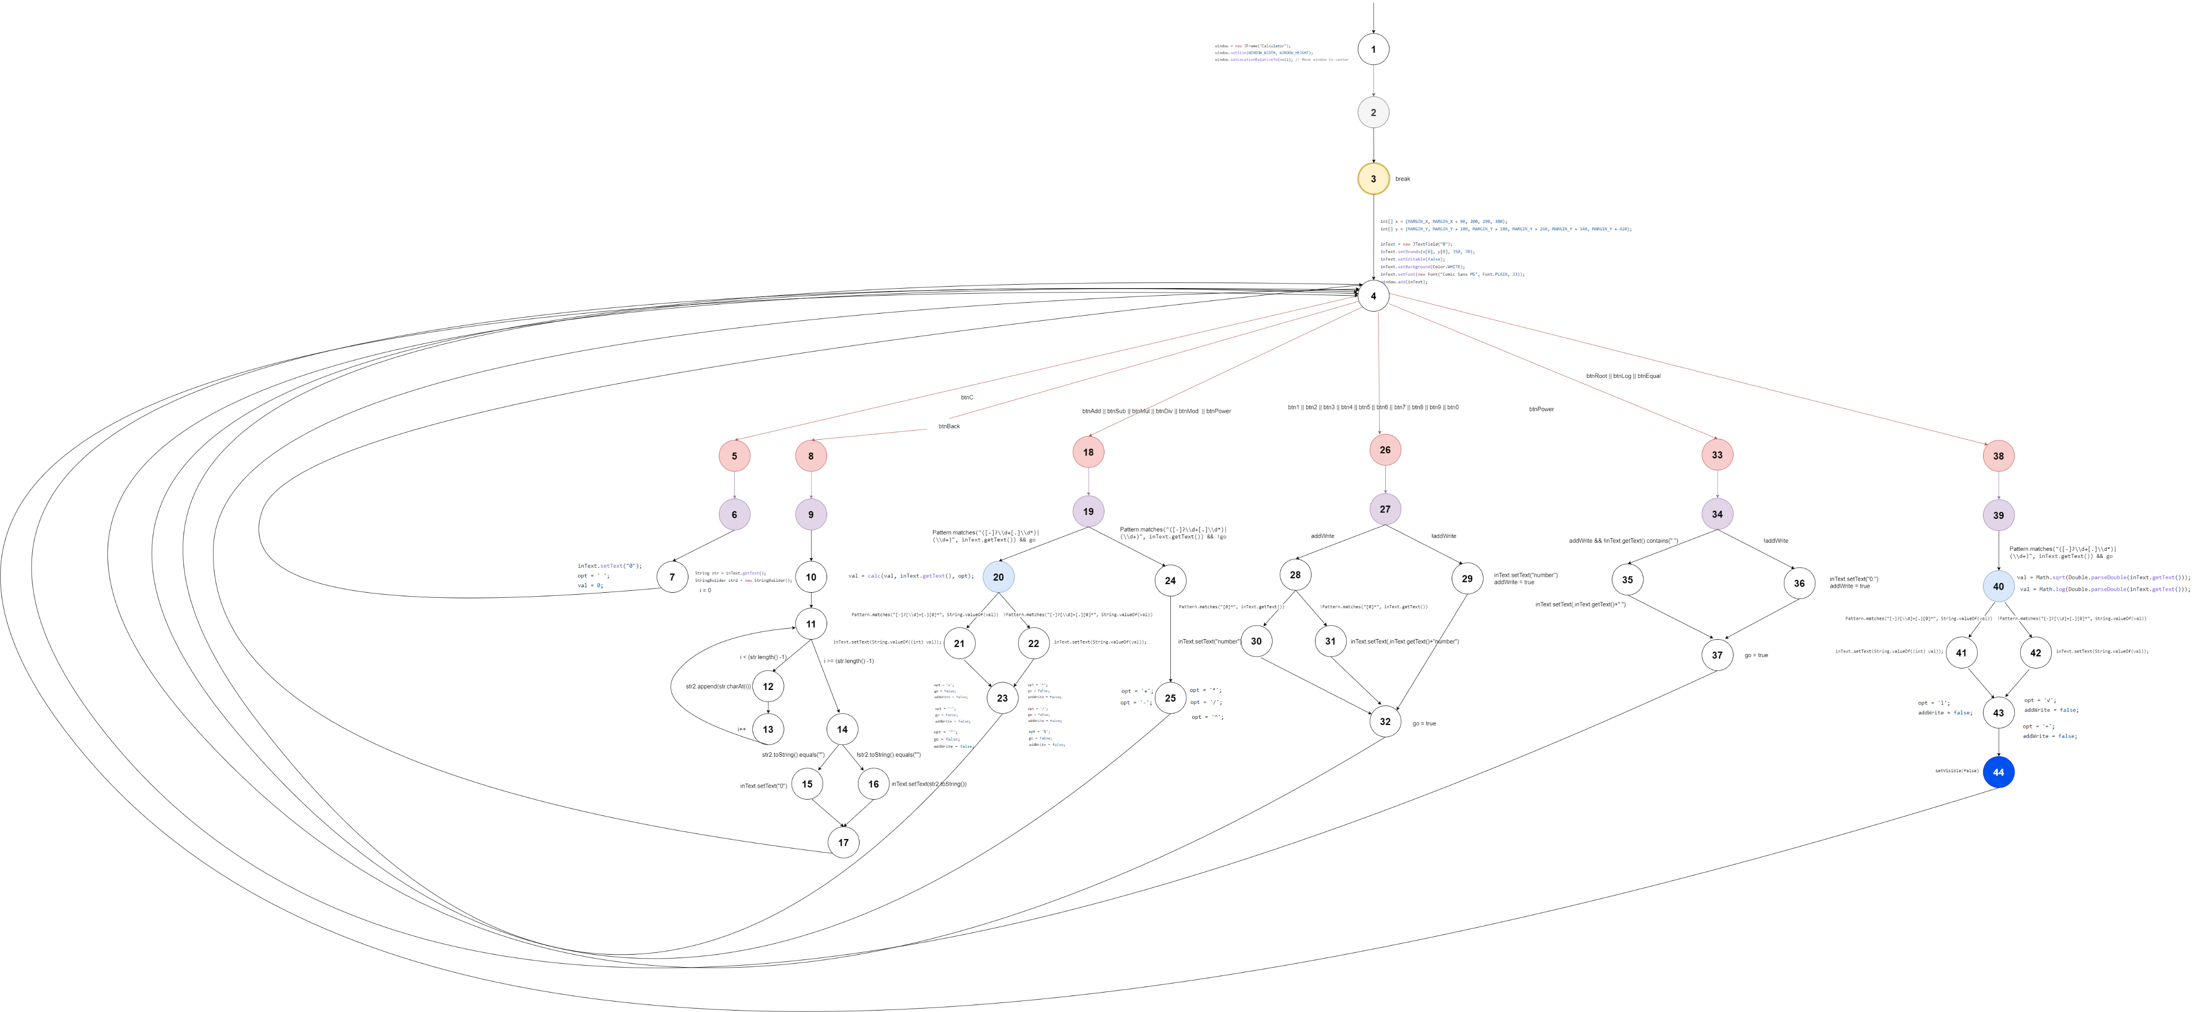
Graph Coverage(CFG)

Slide 6
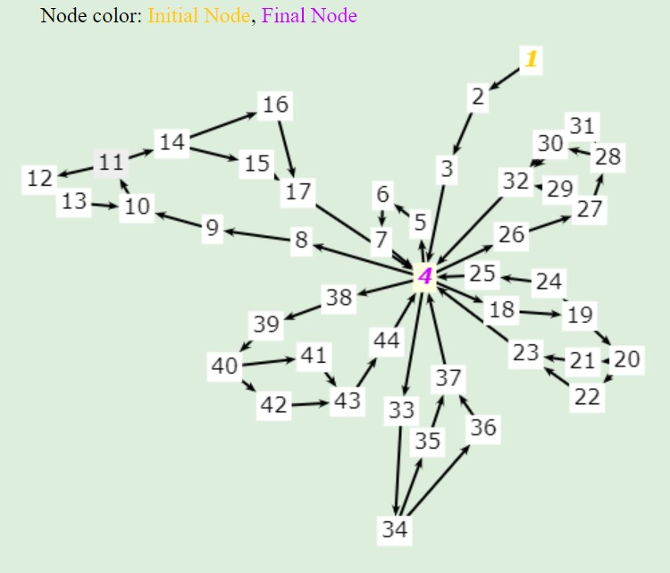
Graph Coverage(EDGE-PAIR)

Slide 7
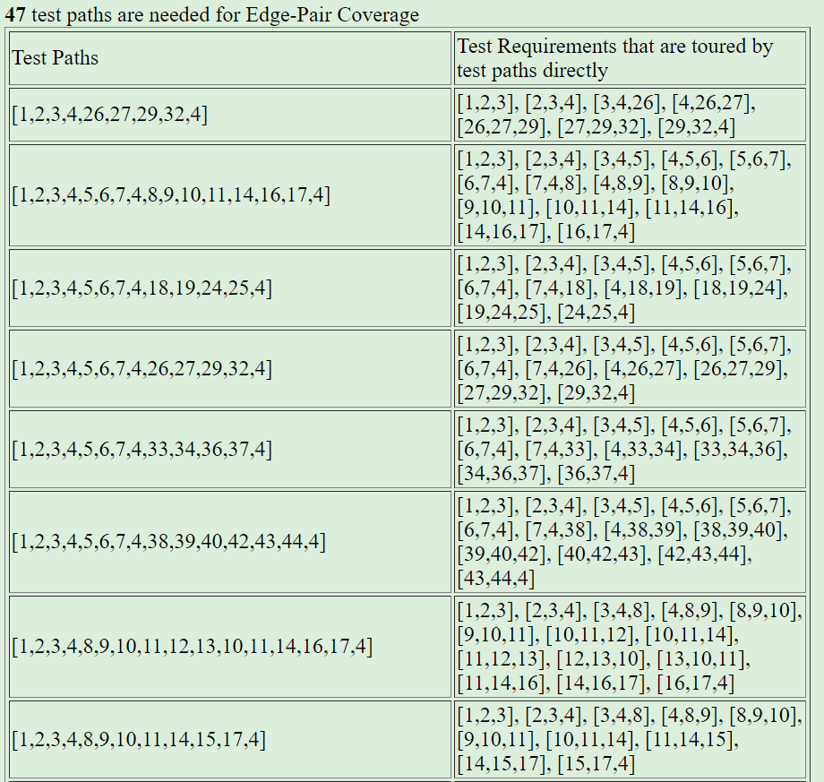
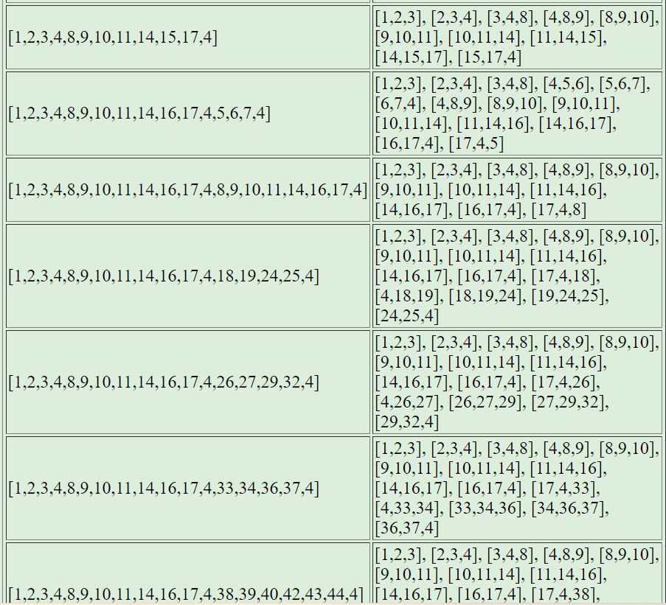
Graph Coverage(EDGE-pair Coverage)

Slide 8
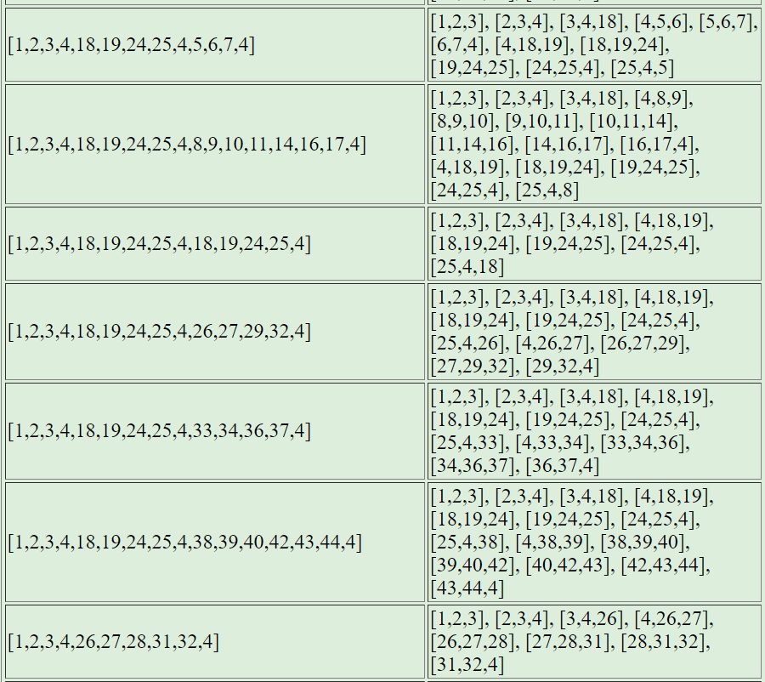
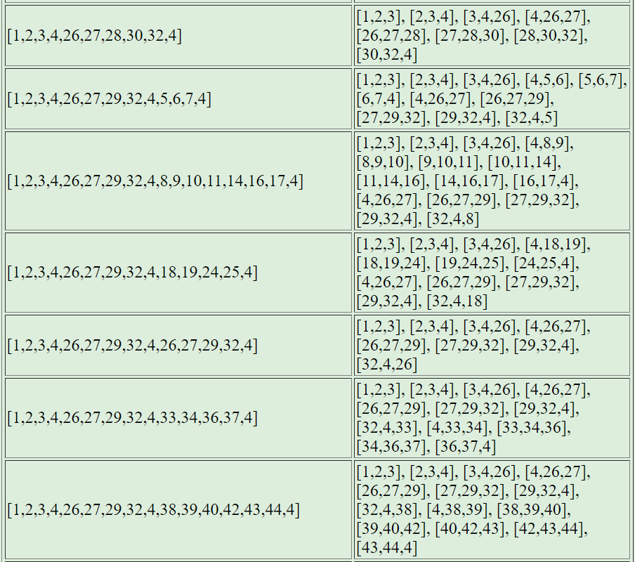
Graph Coverage(EDGE-pair Coverage)

Slide 9
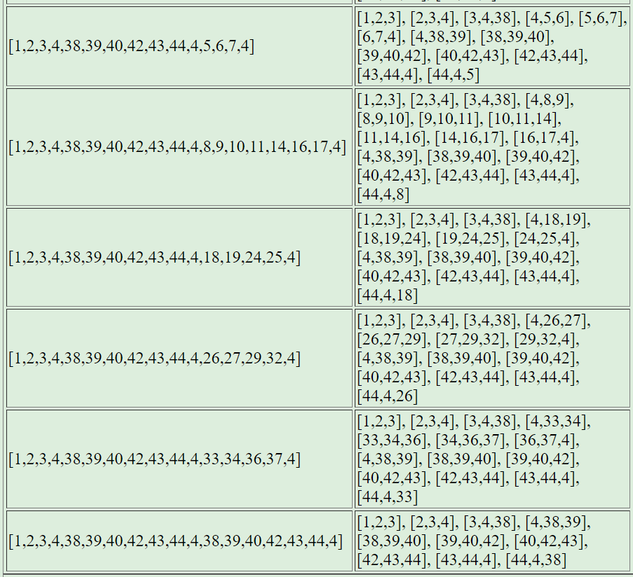
Graph Coverage(EDGE-pair Coverage)

Slide 10
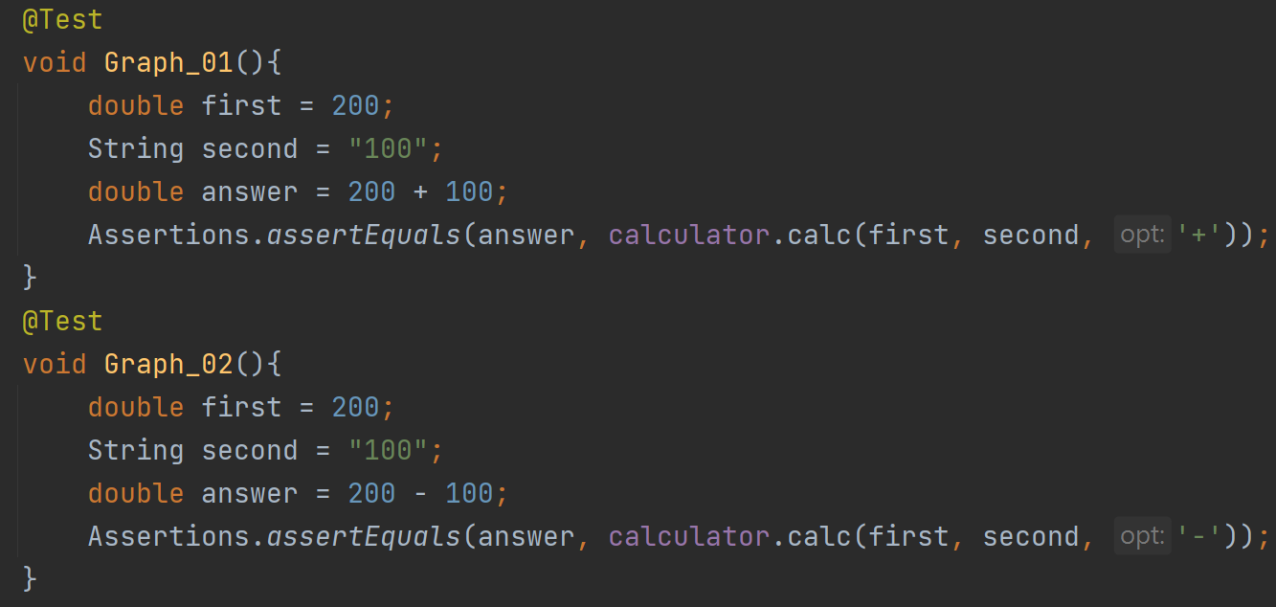
Graph Coverage(EDGE-pair Coverage)

Slide 11
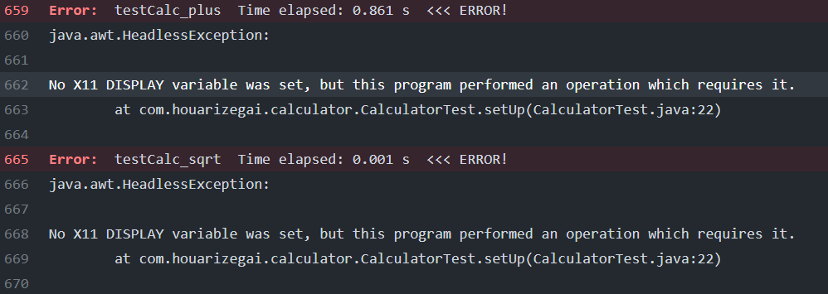
Continuous Integration

Slide 12
Difficulties
大部分按鈕/function皆為private，不修改原始碼難以測試。
Github Action只支援head-less，Swing無法部屬上Github

Slide 13
future
Limit of Data Type
Immediate Operation

